Slide 1
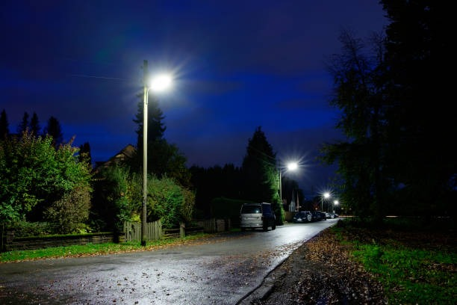

FINDING THE SHORTEST PATH PREVENTING SEXUAL HARASSMENT THROUGH ALGORITHMS

Slide 2



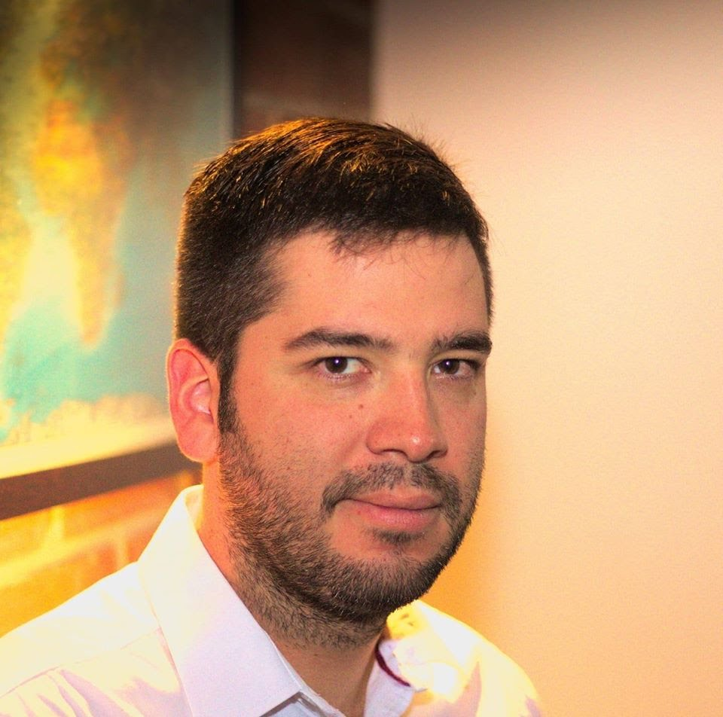
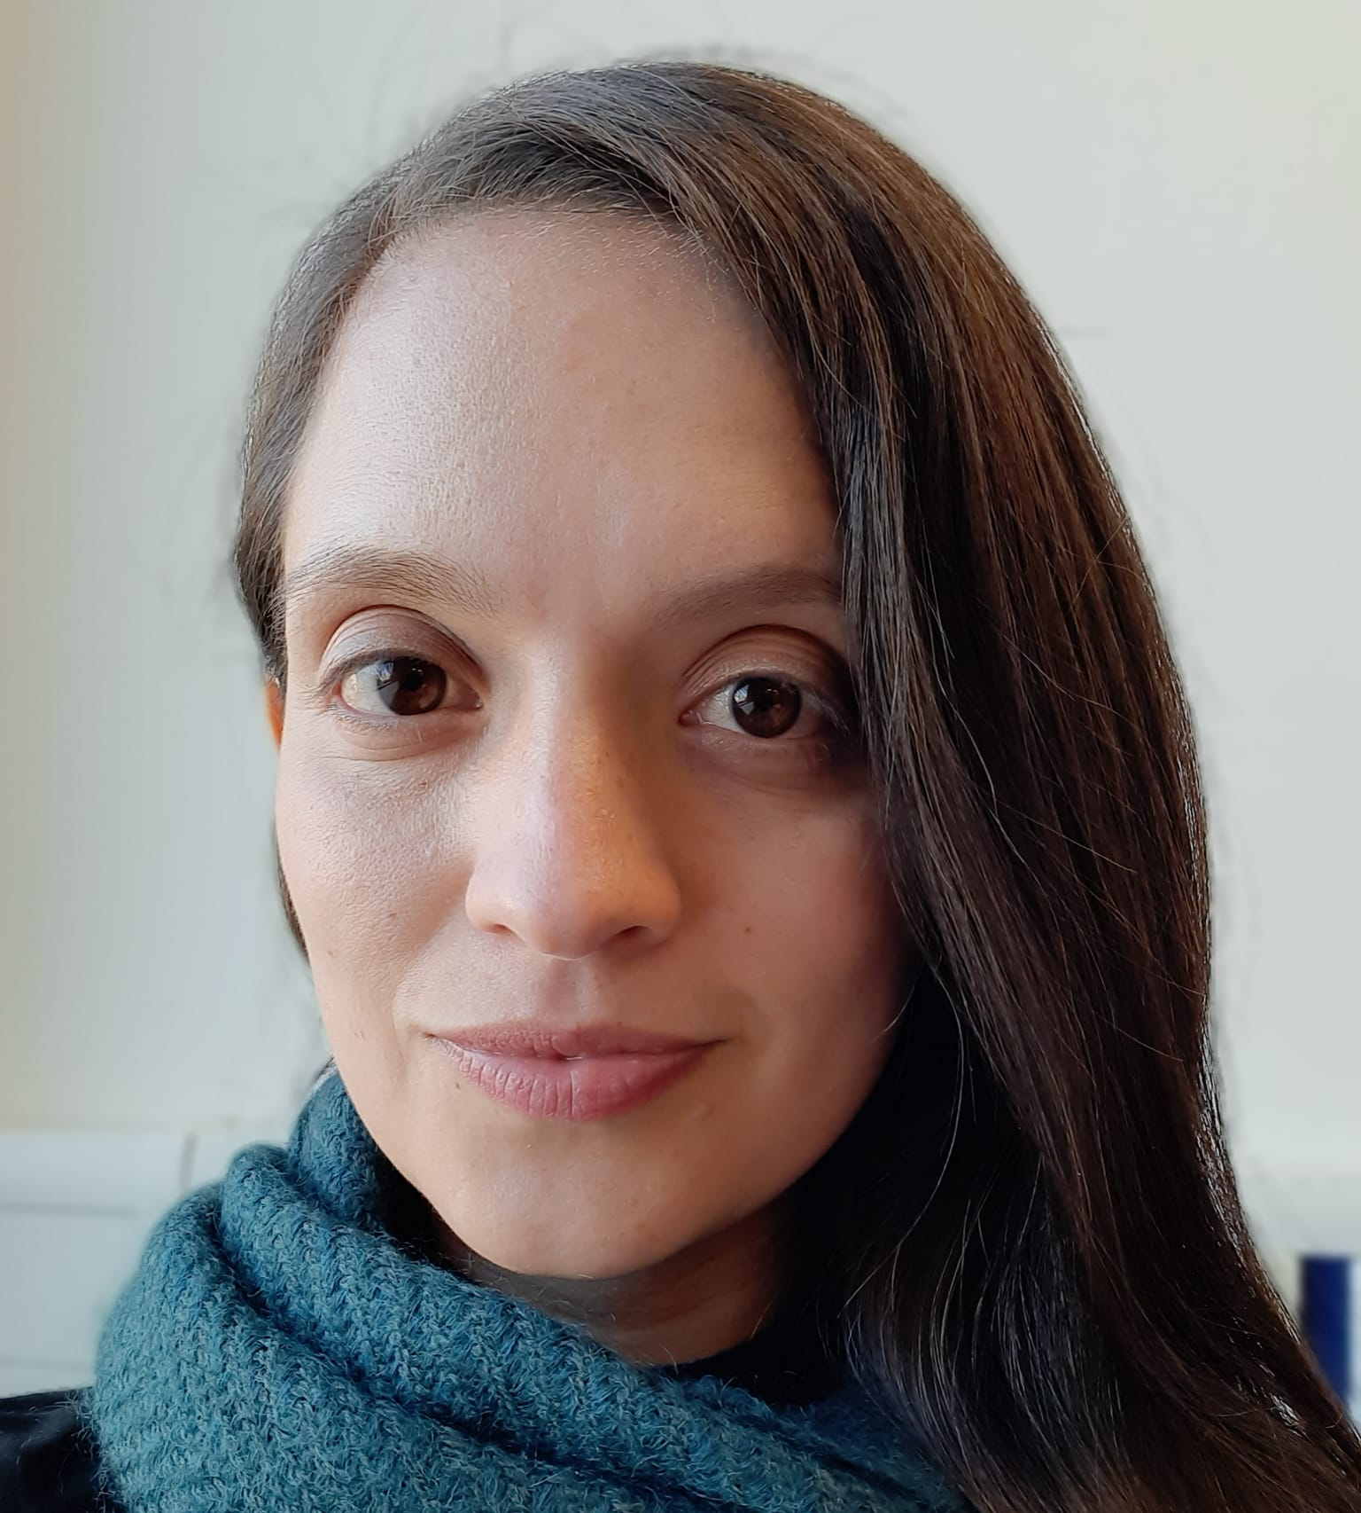

Presentation of the team
Juan Felipe Restrepo
Author
Sara Valentina Cortes
Author
Andrea Serna
Literature review
Mauricio Toro
Data preparation
https://github.com/JuanFelipeRestrepoBuitrago/ST0245

Slide 3
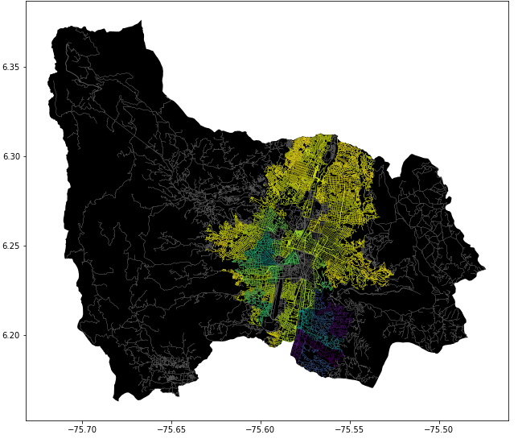
Problem Statement
Shortest path algorithm
Streets
of Medellín, Origin and Destination
Three paths that reduce both the risk of harassment and distance

Slide 4
Solution Algorithm
Dijkstra Algorithm
Streets
of Medellín, Origin and Destination
A path that reduces both distance and harassment

Slide 5
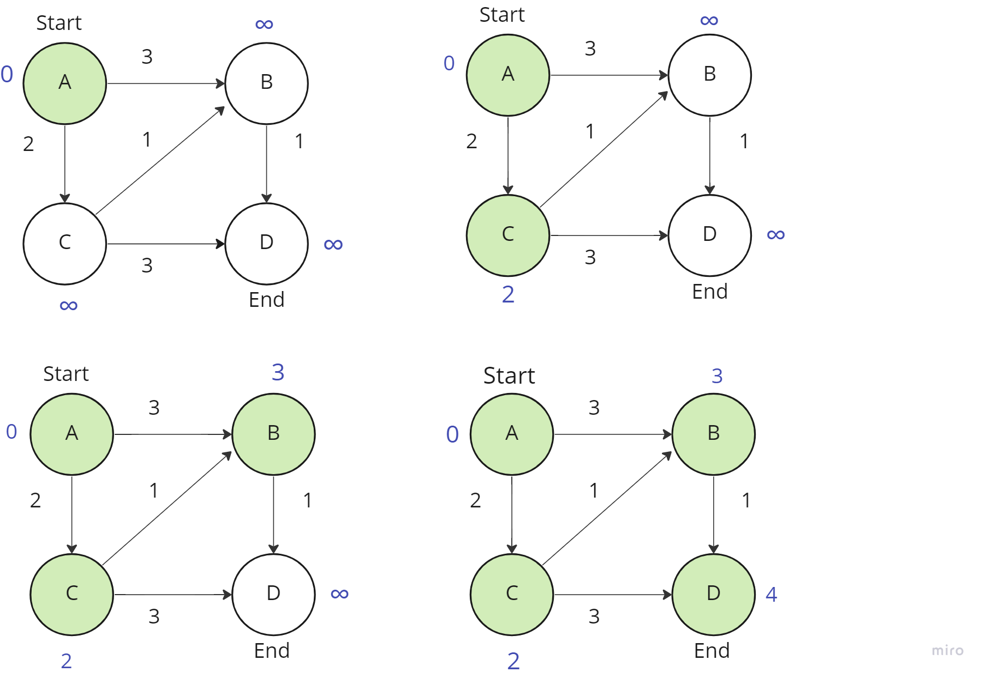
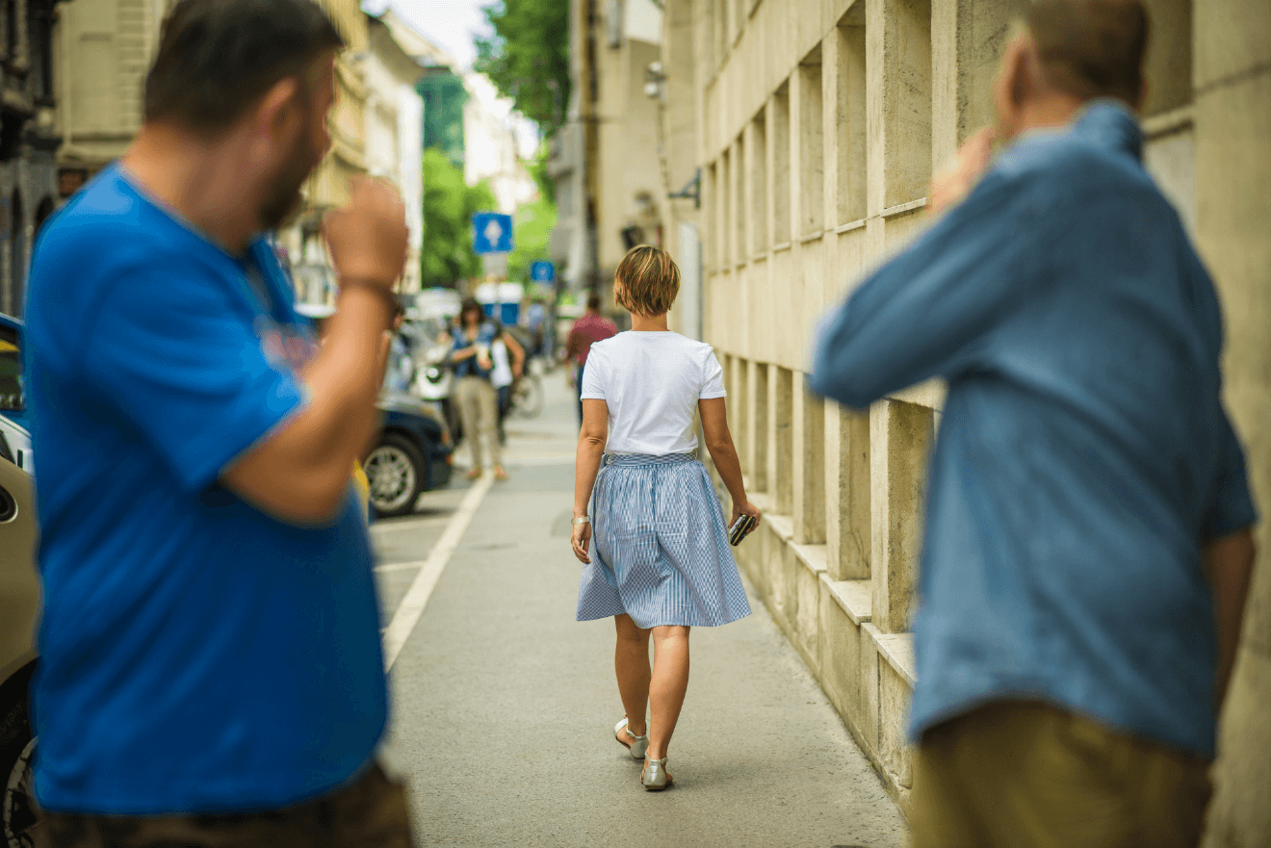
Explanation of the algorithm
Dijkstra Algorithm for the Shortest Path

Slide 6

Complexity of the algorithm
 | Time complexity | Complexity of memory
Dijkstra | O((V+E) Log V) | O(V)
Time and memory complexity of the algorithm name. V is the vertex of the graph and E the edges

Slide 7
First path minimizing distance = ???
Origin | Destination | Distance (meters) | Risk of harassment (between 0 and 1)
EAFIT University | National University | ?? | ??
Distance and risk of harassment for the path that minimizes d = ??. Execution time of ?? seconds.

Slide 8
Second path minimizing harassment risk = ???
Origin | Destination | Distance (meters) | Risk of harassment (between 0 and 1)
EAFIT University | National University | ?? | ??
Distance and risk of harassment for the path that minimizes d = ??. Execution time of ?? seconds.

Slide 9
Third path minimizing distance and harassment risk = ???
Origin | Destination | Distance (meters) | Risk of harassment (between 0 and 1)
EAFIT University | National University | ?? | ??
Distance and risk of harassment for the path that minimizes d = ??. Execution time of ?? seconds.

Slide 10
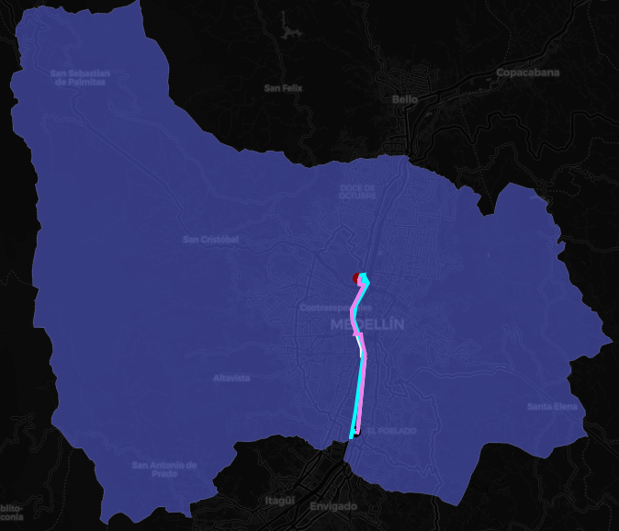
Visual comparison of the three paths

Slide 11

Future work directions
Please name the courses in which you could continue to work on this project.
Optimization 1
Statistics 2
M & S 4
Optimization Bi target
MV risk estimates
Traffic Estimation
Please tell us what you could do, in the following courses, to improve this project.

Slide 12
Complete this slide
For the third installment
Future work directions
Keep this title
Do NOT use red on the slides.
Please name the courses in which you could continue to work on this project.
Databases
Project 1
Software Engineering
Project 2
Other variables
Web application
Mobile application
Include ML or VR
Please tell us what you could do, in the following courses, to improve this project.
The font size must be at least 22 points.
You can add, delete or change some future work addresses

Slide 13
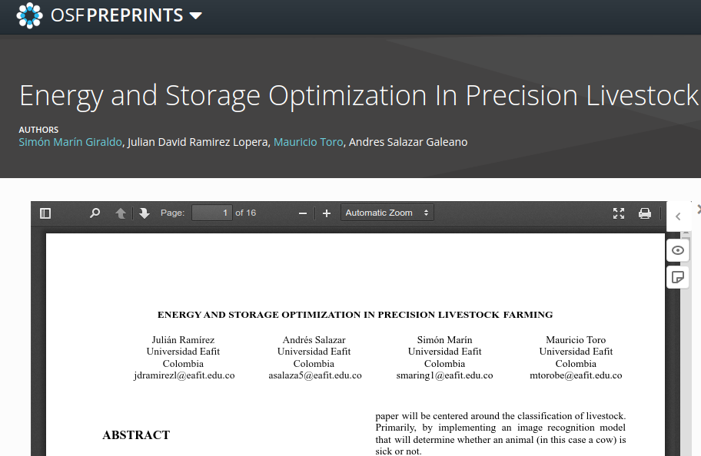
Complete this slide
For the third installment
Report accepted in OSF.IO
Keep this title
Do NOT use red on the slides.
Delete this slide if your report was not submitted to OSF.
This is an example screenshot from a previous report
This is an example of a citation from a previous report
Include the report citation in OSF PREPRINTS and the link. No, not in OSF projects, it is in OSF Preprints.
Julián Ramírez, Andrés Salazar, Simón Marín, Mauricio Toro. Energy and Storage Optimization in Precision Livestock Farming. Technical Report, Universidad EAFIT, 2021. https://doi.org/10.31219/osf.io/du8yt
Include a screenshot of your published report on osf.io and remove the circle
The font size must be at least 22 points.
Include monitors and teachers among the authors, please.

